Slide 1
PUBLIC VERIFIABILITY FOR ENHANCEMENT OF SECRET DATA DELETION WITH TIMEOUT
S.SITTUKALA(111712104094)
S.SUWETHA(111712104104)
E.VASAVI(111712104317)

Slide 2
ABSTRACT
Existing software-based data erasure programs can be summarized as following the same one-bit-return protocol: the deletion program performs data erasure and returns either success or failure. Here we present a cryptographic solution that aims to make the data deletion process more transparent and verifiable. In contrast to the conventional black/white assumptions about TPM (i.e., either completely trust or distrust), we introduce a third assumption that sits in between: namely, “trust-but-verify”. Our solution enables a user to verify the correct implementation of two important operations inside a TPM without accessing its source code: i.e., the correct encryption of data and the faithful deletion of the key. Finally, we present a proof-of-concept implementation of the SSE system on a resource-constrained Java card to demonstrate its practical feasibility. To our knowledge, this is the first systematic solution to the secure data deletion problem based on a “trust-but-verify” paradigm, together with a concrete prototype implementation

Slide 3
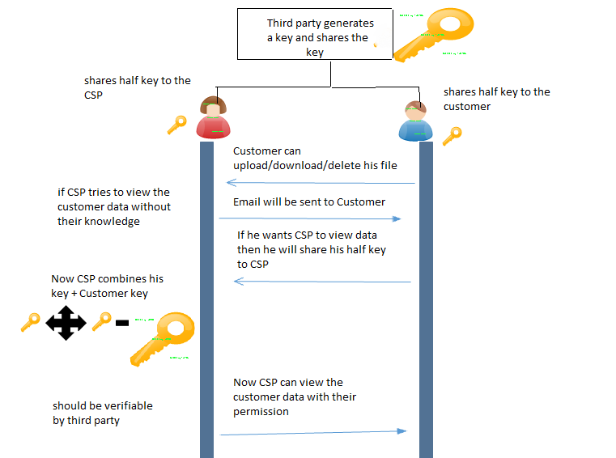
ARCHITECTURE DIAGRAM

Slide 4
SYSTEM DESCRIPTION
We are introducing the third party which generates a long secret key and shares the half part of the long key to the cloud service providers and remaining part of the half key to the customers.
Customers once registers for a new account they can login into the system using their account.
Once after login into the account before performing any operations on file they first request for the third party to generate a long key. Third party as requested by the customers generates a long key and shares their corresponding share to cloud service providers and customers respectively.
Now when the cloud service providers tries to access the file without the knowledge of their customers, immediately an mail should be sent to the customers indicating that CSP is trying to access their data.

Slide 5
If suppose customers want to share their data to the CSP they can share their half part of the key to the CSP. CSP inturn combines his half key with the customers half key which gives full key which should be verified by the third party.
Now the cloud service provider can access the customers file. In our proposed system we are providing privacy to customers data assuring that the customers data cannot be viewed without their knowledge

Slide 6
MODULES
USER SIDE
DATA UPLOAD SCENARIO
1. The end user registers for new account
2. The end user login to the system with his/her username & password.
3. Once the user is authenticated, separate folder has created for the user which monitors all the activities of the user
4. before a user upload the files he has to request for the secret key from the third party
5. once the user receives the key from the third party he can upload the files to the cloud

Slide 7
DATA DOWNLOAD SCENARIO
1. The end user registers for new account
2. The end user login to the system with his/her username & password.
3. Once the user is authenticated, separate folder has created for the user which monitors all the activities of the user
4. once the user receives the key from the third party he can download the files from the cloud

Slide 8
DATA DELETE SCENARIO
1. The end user registers for new account
2. The end user login to the system with his/her username & password.
3. Once the user is authenticated, separate folder has created for the user which monitors all the activities of the user
4. once the user receives the key from the third party he can delete the files from the cloud

Slide 9
ADMIN SIDE
When the admin wants to see the other user files he has to do the following steps
1. Admin enters his half key which is provided by the third party
2. Now he has to request from the user the remaining half key so that by combining his half key and admin half key to view the file
3. once the user wants to share his file to the admin they can provide their half key to admin and grants the admin to view their file

Slide 10
SOURCE CODE
Login.jsp
Import java.io.IOException;
Import java.io.PrintWriter;
Import java.sql.Connection;
Import java.sql.DriverManager;
Import java.sql.PreparedStatement;
Import java.sql.ResultSet;
Import java.sql.SQLException;
Import java.util.logging.Level;
Import java.util.logging.Logger;
Import javax.servlet.RequestDispatcher;
Import javax.servlet.ServletException;
Import javax.servlet.http.HttpServlet;
Import javax.servlet.http.HttpServletRequest;
Import javax.servlet.http.HttpServletResponse;
Import javax.servlet.http.HttpSession;

Slide 11
Import java.io.File;
public class DO extends HttpServlet {
/**
* Processes requests for both HTTP <code>GET</code> and <code>POST</code>
* methods.
*
* @param request servlet request
* @param response servlet response
* @throws ServletException if a servlet-specific error occurs
* @throws IOException if an I/O error occurs
*/String name1,pass1;String a1,a2,a3,a4,a5;
protected void processRequest(HttpServletRequest request, HttpServletResponse response)
throwsServletException, IOException {
response.setContentType("text/html;charset=UTF-8");
PrintWriter out = response.getWriter();
name1=request.getParameter("name");
pass1=request.getParameter("pass");

Slide 12
File f;
try {
Class.forName("com.mysql.jdbc.Driver");
Connection con = DriverManager.getConnection("jdbc:mysql://localhost:3306/icbusys","root","root");
String s="select * from dolog where name='"+name1+"' and pwd='"+pass1+"'";
PreparedStatementpst = con.prepareStatement(s);
ResultSet r = pst.executeQuery();
if(r.next())
{
out.println("<script>"+"alert('login successful')"+"</script>");
String s1="select * from dolog where name='"+name1+"'";
PreparedStatement pst1 = con.prepareStatement(s1);
ResultSet r1 = pst1.executeQuery();

Slide 13
while(r1.next())
{
a1=r.getString(1);
// out.println(a1);
a2=r.getString(4);
a3=r.getString(6);
a4=r.getString(7);
// a5=r.getString(9);
}
HttpSession session=request.getSession();
session.setAttribute("a", a1);
session.setAttribute("b", a2);
session.setAttribute("c", a3);
session.setAttribute("d", a4);
session.setAttribute("name", name1);

Slide 14
f = new File("C:/Users/Documents/ICBUsys/web/files/"+name1);
if (!f.exists()) {
if (f.mkdir()) {
System.out.println("Directory is created!");
} else {
System.out.println("Failed to create directory!");
}
}
// HttpSession session=request.getSession();
// HttpSession session=request.getSession();
// session.setAttribute("aaa", name1);
// out.println(name1);
RequestDispatcher d=request.getRequestDispatcher("do2.jsp");
rd.include(request, response);
}
else if(name1.isEmpty()&&pass1.isEmpty())
{
out.println("<script>"+"alert('pls fill all the fields')"+"</script>");
RequestDispatcherrd=request.getRequestDispatcher("do.jsp");
rd.include(request, response);
}

Slide 15
else
{
out.println("<script>"+"alert('Invalid username and password')"+"</script>");
RequestDispatcherrd=request.getRequestDispatcher("do.jsp");
rd.include(request, response);
}
}
catch (ClassNotFoundException ex) {
Logger.getLogger(DO.class.getName()).log(Level.SEVERE, null, ex);
} catch (SQLException ex) {
Logger.getLogger(DO.class.getName()).log(Level.SEVERE, null, ex);
}
}
// <editor-fold defaultstate="collapsed" desc="HttpServlet methods. Click on the + sign on the left to edit the code.">
/**
* Handles the HTTP <code>GET</code> method.
*
* @param request servlet request
* @param response servlet response
* @throws ServletException if a servlet-specific error occurs
* @throws IOException if an I/O error occurs
*/

Slide 16
// <editor-fold defaultstate="collapsed" desc="HttpServlet methods. Click on the + sign on the left to edit the code.">
/**
* Handles the HTTP <code>GET</code> method.
*
* @param request servlet request
* @param response servlet response
* @throws ServletException if a servlet-specific error occurs
* @throws IOException if an I/O error occurs
*/
@Override
protected void doGet(HttpServletRequest request, HttpServletResponse response)
throwsServletException, IOException {
processRequest(request, response);
}
/**
* Handles the HTTP <code>POST</code> method.
*
* @param request servlet request
* @param response servlet response
* @throws ServletException if a servlet-specific error occurs
* @throws IOException if an I/O error occurs
*/

Slide 17
@Override
protected void doPost(HttpServletRequest request, HttpServletResponse response)
throwsServletException, IOException {
processRequest(request, response);
}
/**
* Returns a short description of the servlet.
*
* @return a String containing servlet description
*/
@Override
public String getServletInfo() {
return "Short description";
}// </editor-fold>
}

Slide 18
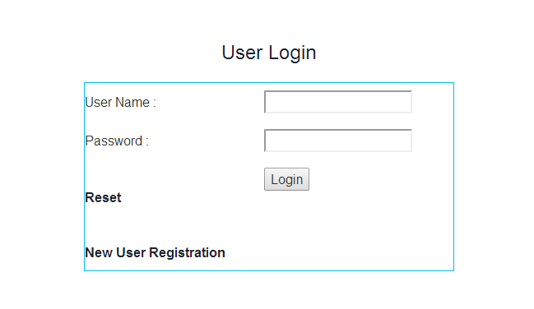
SCREENSHOTS

Slide 19
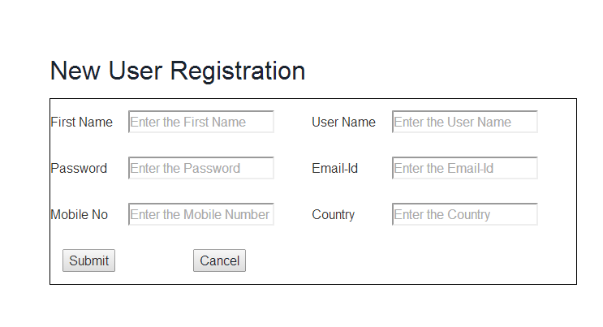

Slide 20
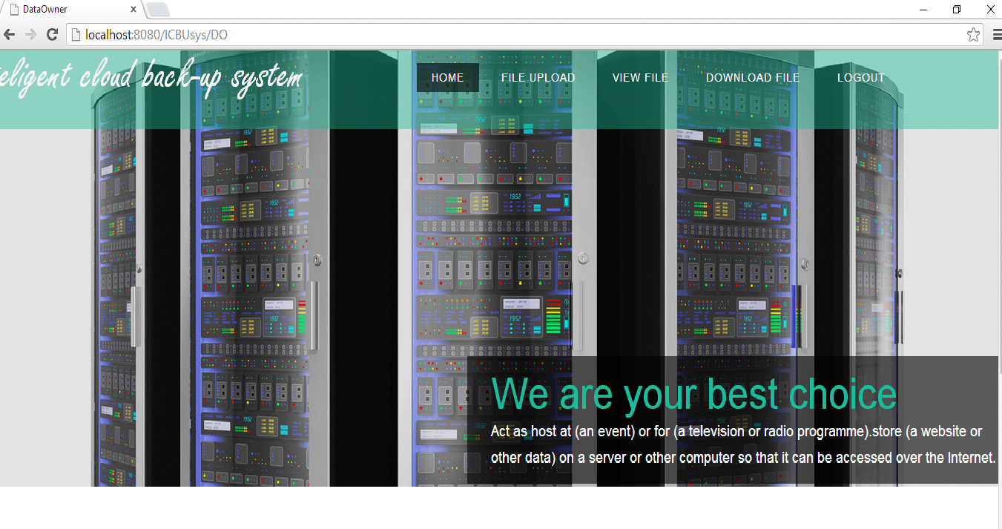
HOME PAGE AFTER USER LOGS IN

Slide 21
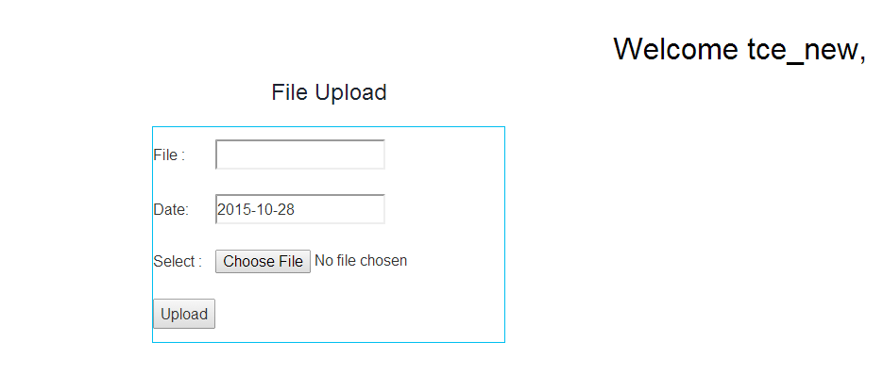
SELECTING THE FILE TO BE UPLOADED

Slide 22
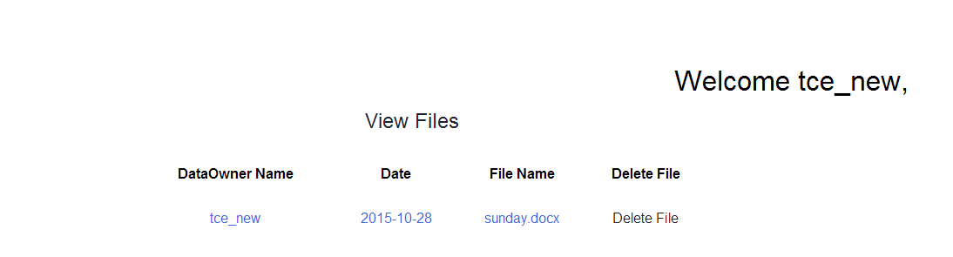
AFTER ADDING FILE TO CLOUD

Slide 23
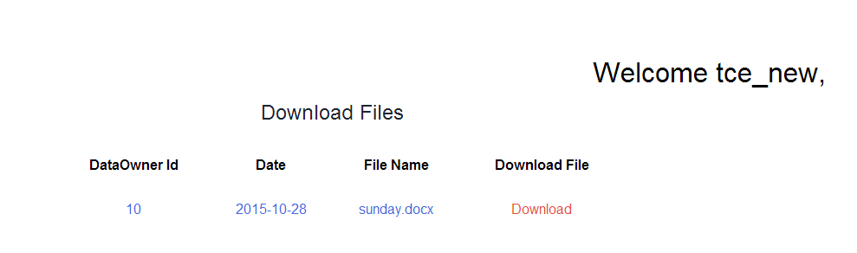
DOWNLOADING EXISTING FILE FROM CLOUD

Slide 24
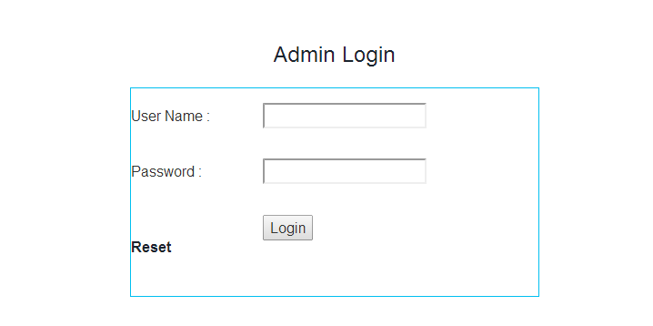
ADMIN LOGS IN TO SEND KEY TO USER

Slide 25
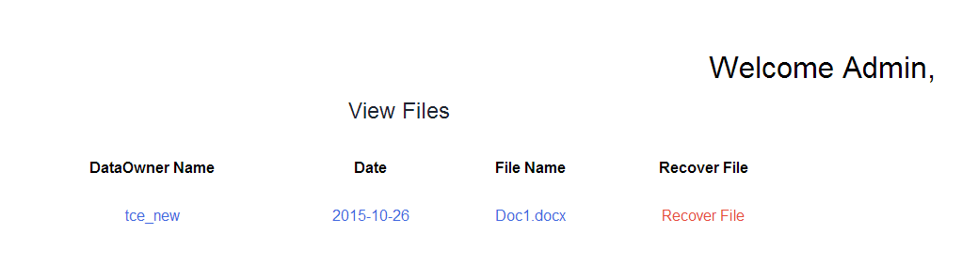
ADMIN RECOVERS DELETED FILES

